Slide 1
Requirements Management with Use Cases
Module 4
Understanding Stakeholder Needs

Slide 2
Course Outline
0 - About This Course
1 - Best Practices of Software Engineering
2 - Introduction to RMUC
3 - Analyzing the Problem
4 - Understanding Stakeholder Needs
5 - Defining the System
6 - Managing the Scope of the System
7 - Refining the System Definition
8 - Managing Changing Requirements
9 - Requirements Across the Product Lifecycle

Slide 3
Understanding Stakeholder Needs - Overview
I need …
Problem Space
Problem
Needs
Solution Space
Features
Traceability
The Product To Be Built
Software
Requirements
Test Procedures
Design
User Docs
Notes:
At this point, we will work on making sure that we have considered all stakeholder requests, what needs are addressed by these (relating to the problem we have agreed to address), and what features in the system we might use to address these needs.
Stakeholder requests come in at many different levels of detail -- often not expressed as a real need, but sometimes as a feature of the system, or even as a change to a software requirement.
In this unit, we will discuss how we can effectively communicate with our stakeholders to figure out what their “real needs” are.
Use this slide to explain where we are in the class:
At this point, we will work on making sure that we have considered all stakeholder requests, what needs and goals are addressed by these (in the problem space), and what features in the system might address these.

Slide 4
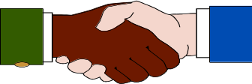

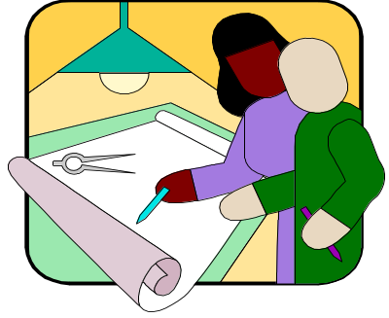


What Are Sources for Our Requirements?
Requirement Specs
Business Plans
Personal Goals
Business Models
Partners
Customer
Analyst
Bug Reports
Change Requests
Domain Experts
Industry Analysts
Site Visits
Competitive info.
Problem Domain
Users
Notes:
We need to capture requests from all stakeholders, and specify how these requests will be addressed. Although the system analyst is responsible for gathering this information, many people will contribute to it: marketing people, end users, customers -- anyone who is considered to be a stakeholder in the project.
Other examples of external sources for requirements are:
Statement of work
Request for proposal
Mission statement
Problem statement
Business rules
Laws and regulations
Legacy systems
Business models
Any results from requirements elicitation sessions and workshops

Slide 5
What Are The Characteristics of Our Customers?
Technology Adoption
Profile
“Crossing the
35%
CHASM”
30%
25%
20%
% of Target Domain Customers
15%
10%
5%
0%
Time
(the lifecycle of the technology)
INNOVATORS
Technical Influence
No Money
Discontinuous innovation
Company specific
EARLY ADOPTERS
Have money
Strong Influence
Specific features
EARLY MAJORITY
Pragmatists
Mission critical systems
Reliability
Whole product solutions
LATE MAJORITY
Conservatives
Price sensitive
Simplify
Commodity
Demanding
LAGGARDS
Skeptics
Price
Moore, 1991
Notes:
This chart comes from the book Crossing the Chasm, by Geoffrey Moore. As a technology progresses through its lifecycle, it appeals to different types of customers.
Notice that there is a gap in the bell curve in moving from each type of customer to the next. The biggest problem most products encounter (the chasm) is moving from early adopters to early majority. What is the key to getting across the gaps (making the transitions from one type of customer to the next)? Even if you have a good (or great) product -- the key is marketing -- getting the word out.
It is important to know the characteristics of the customers that will be purchasing your product. Where do they fit on this curve in relationship to the technology of your product? Are you appealing to the proper characteristics of your target customers?
The implication for gathering requirements is that each marketing group will have different kinds of needs. In gathering requirements, be sure to get your customer requests from the marketing group to which you want to appeal.
This chart comes from the book Crossing the Chasm, by Geoffrey Moore.
See student notes for points to emphasize.

Slide 6
What Problems Might Be Encountered?
Stakeholders know what they want but may not be able to articulate it.
Stakeholders may not know what they want.
Stakeholders think they know what they want until you give them what they said they wanted.
Analysts think they understand user problems better than users.
Everybody believes everybody else is politically motivated.
Notes:
What are some of the problems you have encountered in determining your stakeholder needs?
Users often don’t know what they want.

Slide 7
What Does This Process Look Like?
Ad hoc requirements
Requirements Spec
Rejected
Reworked Spec
Rejected
Customer
Reworked again
Development
Approved !
Notes:
Continuous discussions should occur between development and the customer until an agreement is reached on the requirements of the system.
Expect to rework the requirements until you gain agreement with the customer and the other stakeholders in the project.

Slide 8
Techniques for Eliciting Stakeholder Needs
Requirements Workshop
Brainstorming & Idea Reduction
Use Cases
Interviews
Questionnaires
Role Playing
Business Modeling
Reviewing Customer Requirement Specifications
Notes:
We will discuss briefly each of these techniques in the following slides.
What follows is a crash course in elicitation techniques. We will briefly discuss each topic in turn.
Many of these techniques can be used together.
There are many other techniques such as:
Production software
Task analysis
...
Note:
Storyboarding and prototyping have been moved to “Module 7: Refining the System Definition”.

Slide 9

Requirements Workshops
Accelerate the Elicitation Process
Gathers all stakeholders together for an intensive, focused period
Facilitator runs the meeting
Everyone gets their say
Results immediately available
Provide a framework for
applying the other elicitation
techniques we will be
discussing
Notes:
A requirements workshop is one of the most cost-effective and time-efficient means to get feedback. The same concepts are used in JAD (Joint Application Development) or RAD (Rapid Application Development) sessions.
Ask: “Has anyone participated in a similar workshop?”
This section is much more effective if it is presented in the context of a real (or close to real) workshop in which you have actually participated -- or at least in the context of an imaginary one which you might want to set up.

Slide 10
Workshops: Planning and Executing
PRE
WORKSHOP
SESSION
PRODUCTION
FOLLOW-UP
Sell the workshop
Establish team
Handle logistics
Issue warm-up
material
Prepare agenda
Facilitate
Keep on track
Record findings
Summarize conclusions
Synthesize findings
Condense info
Present to customer
Determine next steps
Notes:
Here are some suggestions on planning and executing a requirement workshop. Make sure you gather the right stakeholders. Who will they be?
Give example of a workshop like this that you have attended or facilitated.
Or perhaps get a student to share an example.
If you don’t have your own example, you can tell about the workshop that was pulled together with the 3 amigos at Rational, Phillipe Krutchen (Process group), and Walker Royce (process guru), with the Requisite executive managers to determine how RequisitePro should fit into the Rational product line and process.

Slide 11
Workshops: Tricks of the Trade
Problem
Solution
Hard to get restarted after
“Late From Break” ticket,
breaks
Kitchen timer, Charitable
contribution box ($1 after
ticket used)
Pointed criticism - petty
biases, turf wars, politics
“1 Free Cheap Shot”
ticket, “That’s a Great
and cheap shots
Idea!!” ticket
Grandstanding,
Trained facilitator, “Five
domineering positions,
Minute Position
uneven input from
Statement”
participants
Flagging energy after
Light lunches, breaks,
lunch
coffee, soda, candies,
cookies, rearrange room,
change temperature
Notes:
What are some of the problems you encounter when running a session such as this? How do you handle them?
Switch back and forth between this slide and the next to show how the Workshop tickets can be used to help with these problems.

Slide 12




Workshop Tickets
Late From
Break
1 Free
Cheap Shot
That’s a
Great Idea!!
That’s a
Great Idea!!
Five Minute
Position
Statement
Five Minute
Position
Statement
Notes:
Here is an idea of how you can be creative in finding ways to control the Requirement Workshop meeting.
Can tell how these were effective with the 3 Amigos workshop referred to earlier.
Each of the top two tickets are thrown into a box as used, afterwards, it costs $1.
Bottom 2 tickets are for 5-minute position statements in which the user is given the floor for 5 minutes; can use white board or easel to explain position; no questions or comments from the floor except for clarification.
Middle two tickets: Original owner puts their initials on their two tickets. Give to someone else when you recognize a great idea they have shared. Goal at the end of the day is to have only tickets with other’s initials on them. Be open to recognizing as well as sharing great ideas.

Slide 13
Brainstorming
Rules for Brainstorming
Clearly state the objective of the session
Generate as many ideas as possible
Let your imagination soar
Do not allow criticism or debate
Mutate and combine ideas

Slide 14
Brainstorming Exercise
1. Prepare
  Stack of Post-Its for each participant
  Large markers for all
2. Gather Ideas
  Write it down
  Shout it out
  Facilitator posts on board
3. Prune Ideas
  Combine like ideas
  Eliminate outrageous ideas
4. Organize Ideas
  Move the cards around
  Could organize by FURPS
Notes:
The purpose of this exercise is to help you experience and try some useful techniques that can be used with brainstorming.
Take the class project that you determined in Unit 2 and come up with some high-level features that people would like to see in the system.
Have the students shout out the idea to the facilitator. They should also write a short description (3-4 words) on a post-it note with a large marker so all can read.
The facilitator collects these and places them on the easel.
Let this continue until you have the easel fairly filled with features (20 or so).
Then, go through each one to make sure everyone understands -- any questions, have original requestor explain.
Combine similar ideas.
Throw out the ideas that everyone agrees are outrageous.
Number each of these features so students can vote on them (see next page).
If you have time, have the class actually vote (see next page).
RECOMMENDED:
Whole-class exercise.
Estimated Time:
10-15 minutes for brainstorming.
5-10 minutes for voting.

Slide 15
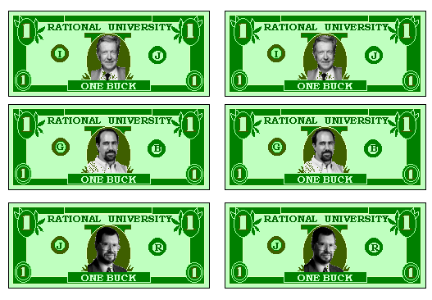
Brainstorming: Idea Reduction
Discard redundant and outrageous ideas
Store “needs more development” ideas
Blend ideas
Prioritize those that remain
  Vote
    Single vote
    Cumulative voting
      Buy features
  Apply evaluation criteria
    Non-weighted
    Weighted
RU “bucks”
Notes:
Now, what do you do after you have gathered all these “great ideas”?
What are some ways this method can be “cheated”?
Someone puts all their money on their pet item which is unpopular with everyone else.
What would have been better ways to pay for the features in the previous exercise?
Perhaps using “critical”, “important”, “useful” and weighting the 9-3-1.
Blind voting.

Slide 16
How Can a Use-Case Model Help Elicit Needs?
Discuss with customer what the system will do
Identify who will interact with the system
Identify what interfaces the system should have
Help verify that no requirements are missing
Verify that developers understand requirements
Use-Case Model
Notes:
We will present a use-case model for defining our requirements, but we will often find that as we develop this model, it will uncover other needs that were not apparent originally.
As a high-level elicitation technique, use cases and actors should be identified. This gives us a context for finding the needs of the stakeholders in terms of the functionality and interfaces of the system.
In conjunction with identifying use cases, we might need to use our other elicitation techniques. For example, it is common to hold a requirements workshop for the purpose of identifying use cases.

Slide 17
What Is a Use Case? Key Words and Phrases
A
use case
defines a sequence of
actions
performed by a system that yields an observable result of value to an actor
  A use case describes a set (class) of possible executions of the system
    A specific execution (instance) of a use case is a scenario
    Work on the class level to identify and describe the use case
  Set of atomic activities, decisions, and requests
    May be performed fully or not at all
    Started by actor
Notes:
15
This slide and the following slide will point out the key principles that should be kept in mind when defining use cases. There are many pitfalls that can be avoided by keeping these key words and phrases in mind.
Emphasize the importance of each of the key phrases in the definition of a use case.
There may be a discussion of automatic processes: Are they started by an actor? What about functions that start due to a change in the state of the system?
In general, all use cases should be initiated by an actor. Perhaps this can be modeled as the system clock (Father Time?) or maybe the person who set up the rules for the automatic processing.

Slide 18
What Is a Use Case? Key Words and Phrases
A use case defines a sequence of actions
performed by a system
that yields an
observable result of value
to
an actor
Describes functions of the system
To avoid too detailed use cases
To avoid too complex use cases
Notes:
16

Slide 19
Define System Boundaries and Functions
A Simple Phone System
Caller
Place Local Call
Callee
Place Long Distance Call
Long Distance
Provider
Customer
Bill Customer
Billing Manager
A model of what the system does and who it does it for

Slide 20
Useful Questions in Identifying Use Cases
What are the primary tasks the actor wants the system to perform?
Will the actor create, store, change, remove, or read data in the system?
Will the actor need to inform the system about sudden, external changes?
Does the actor need to be informed about certain occurrences in the system?
Will the actor perform a system startup or termination?
Use Case
Notes:
Here are some questions that are useful for helping you find the use cases in your system.

Slide 21
Exercise: Identify Possible Use Cases
Our System
Notes:
For each of the actors we identified in the last module, think of the types of interactions each might have had with our system.
Remember, this is at a very high level (see the next slide for an example).
Don’t spend too much time on this yet. We will be going into this in more depth in the next unit, including interactions, etc. Just sketch a diagram of 3-5 use cases.
Do this as a class exercise.
Look back at the actors defined in the exercise in the previous module.
For each of these actors, get the students to suggest the types of interactions each might have with our system.
Remember, this is at a very high level (see the next slide for an example).
Don’t spend too much time on this yet. We will go into this in more depth in the next unit (including interactions, etc.) Just sketch a diagram of 3-5 use cases.
This will provide a context in which we might use our other elicitation techniques.
RECOMMENDED:
Whole-class exercise.
Estimated Time: 8-10 minutes.

Slide 22
A Use-Case Model Diagram
A Recycling Machine
Customer
Recycle Items
Operator
Print Daily Report
Change Refund Values
Manager
Add New Bottle Type
A model of what the system is supposed to do (use cases), and the system's surroundings (actors).
Notes:
The use-case model describes the system, its environment, and how the system and its environment are related. It tells us WHAT the system should do (and not HOW the system should do it).
A use-case diagram shows actors, use cases, use-case packages, and their relationships.
This sample shows the use-case model for a recycling machine. It has even more use cases which will turn up later.
The important point here is that the simple overview of the use-case model gives you an idea of what this system is doing -- and it has to be from the user’s point of view. The manager of a store can understand the scope of the system from a picture like this.

Slide 23
Interviews
A direct technique that can be used in both problem analysis and requirements elicitation
Designed to gain an understanding of real problems and potential solutions from the perspectives of the users, customers, and other stakeholders
Notes:
Interviewing is probably the most useful technique to directly get needs from your stakeholders. It is helpful to interview key stakeholders for your project.
Refer back to the interview exercise we did at the beginning of the class to determine their needs for this class.

Slide 24
Interviews: The Context-Free Question
The context-free question is a high-level, abstract question that can be posed early in a project to obtain information about global properties of the user’s problem and potential solutions.
Context-free questions:
  Are always appropriate
  Help you understand stakeholder perspectives
  Are not biased with solutions knowledge
Gause & Weinberg, 1989
Notes:
Four types of interview questions will be considered:
User
Process
Product
Meta-questions
The context-free question is discussed in the book Exploring Requirements:Quality Before Design by Gause & Weinberg that is listed as recommended reading in the appendix.

Slide 25
Interviews: Context-Free User Questions
Who is the customer?
Who is the user?
Are their needs different?
What are their backgrounds, capabilities, environments?
Use as input when defining actors for Use Cases
Gause & Weinberg, 1989
Notes:
One of the 4 types of interview questions:
User
Process
Product
Meta-questions

Slide 26
Interviews: Context-Free Process Questions
What is the problem?
What is the reason for wanting to solve this problem?
Are there other reasons for wanting to solve this problem?
What is the value of a successful solution?
How do you solve the problem now?
What is the trade-off between time and value?
Where else can the solution to this problem be found?
Gause & Weinberg, 1989
Notes:
One of the 4 types of interview questions:
User
Process
Product
Meta-questions

Slide 27
Interviews: Context-Free Product Questions
What problem does this product solve?
What business problems could this product create?
What hazards could exist for the user?
What environment will the product encounter?
What are your expectations for usability?
What are your expectations for reliability?
What performance/precision is required?
Gause & Weinberg, 1989
Notes:
One of the 4 types of interview questions:
User
Process
Product
Meta-questions

Slide 28
Interviews: Context-Free Meta-questions
Am I asking too many questions?
Do my questions seem relevant?
Are you the right person to answer these questions?
Are your answers requirements?
Can I ask more questions later?
Would you be willing to participate in a requirements review?
Is there anything else I should be asking you?
Gause & Weinberg, 1989
Notes:
One of the 4 types of interview questions:
User
Process
Product
Meta-questions

Slide 29
Interviews: Non-Context-Free Examples
Leading questions
  You need a larger screen, don’t you?
Self answering questions
  Are fifty items about right?
Controlling statements
  Can we get back to my questions?
Too long-too complex
  I have a three part question, ...
What are better questions to ask?
Notes:
It is easy to fall into some potholes if context-free questions are not used in the interview.
Discuss each of these types of questions briefly.
What might be a better way to ask each of these?

Slide 30
Interviews: Caveats
Don't ask people to describe things they don’t usually describe.
  Assumes that users can describe complex activities
  Example: tying your shoelace
  In general, people can do many things they cannot describe
  Empirical evidence - poor correlation
Ask open-ended questions
Avoid questions that begin with “Why…?”
  Can provoke a defensive posture
Don’t expect simple answers
Don’t rush the interviewee for answers
Listen, listen, listen!
Notes:
Here are some hints to help you avoid the dangers.

Slide 31
Template For A Generic Interview: Handout
Handout
TP: Generic Interview Template

Slide 32
Questionnaires
Widely used
Appear scientific because of statistical analysis
Applicability to broad markets where questions are well defined
Assumptions
  Relevant questions can be decided in advance
  Phrased so reader hears in intended way
  Suppresses much that is good about analysis
Can be powerful, but not a substitute for an interview
© 1994 by Alan M. Davis
Notes:
A questionnaire can be useful for gathering data, but it should still be prefaced by interviews to determine the correct questions to ask. How many customers should be interviewed to determine a good cross-section of questions? Usually 12-15 is adequate.
Most items should be categorized to allow for statistical analysis.
Always leave some open-ended questions to allow for new ideas.
Should still be prefaced by interviews to determine the correct questions to ask. How many customers should be interviewed to determine a good cross-section of questions? Usually 12-15 is adequate.
Most items should be categorized to allow for statistical analysis.
Always leave some open-ended questions to allow for new ideas.

Slide 33

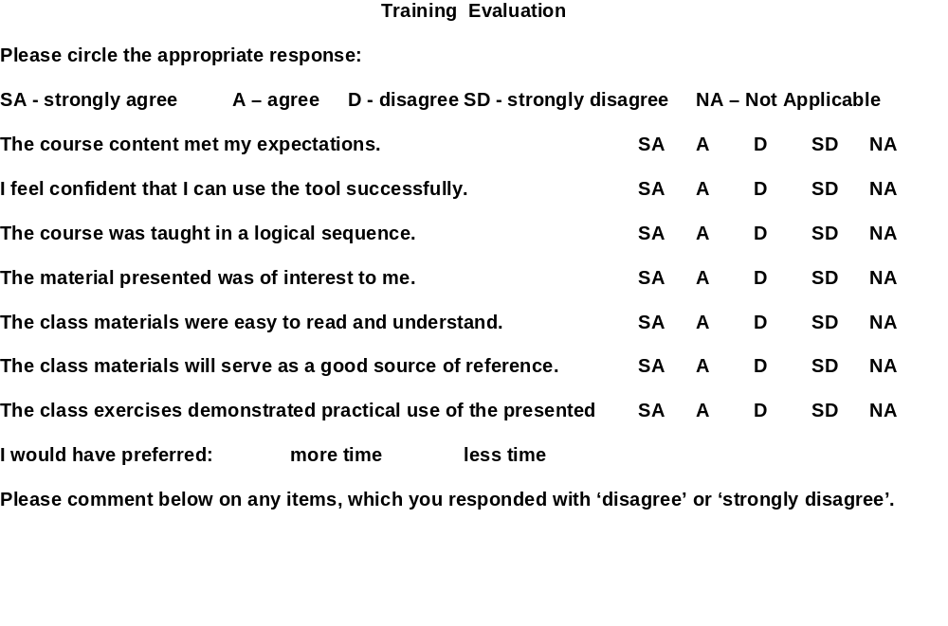
Course Feedback Questionnaire: Handout
Notes:
This questionnaire was created to elicit feedback on the delivery of this course. It provides Rational University with customer requirements for enhancements to the course.
The full questionnaire is included at the end of the manual for you to complete at the end of class
Here is an example questionnaire.
Point out the different types of questions included.

Slide 34

Role Playing
Tools and Techniques
  Scripted walkthroughs
  Scenario analysis
  Class Responsibility Collaboration
  (CRC) Cards
Have the analyst play the role of user or customer to gain real insights into the problem domain
Have the customer play the role of a user to understand the problems they may face
Notes:
If the people you are getting requirements from are not the actual user, sometimes it can be useful to have them take on the role of a user and walk through some user scenarios.
Ask group if they’ve used this technique.
If anyone has used CRC cards they can share how they were used and if they were successful.
The CRC Card technique is based on paper by Kent Beck and Ward Cunningham. The technique was made popular by Rebecca Wirffs-Brock.

Slide 35
What About Business Modeling?
From a business perspective, a business model may be used to:
  Understand the organization
  Visualize the organization and its processes
  Find ways to make the organization more efficient
  Re-engineer the organization
  Provide proof that the information technology adds value
Notes:
The approach to business modeling presented in the Rational Unified Process includes a concise and straightforward way to generate requirements on supporting information systems. A good understanding of business processes helps you to build the right systems.
Even more value is added if you also use people's roles and responsibilities, as well as definitions of what "things" are handled by the business, as a basis for building the system. It is from this more internal view of the business (captured in a business object model) that you can see its tightest link to other models of the system and how they should appear.

Slide 36
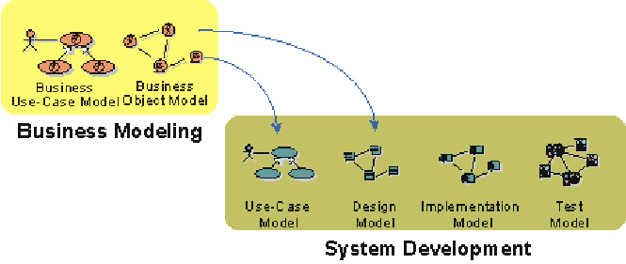
Business Models Provide Input to Systems
What should business models show?
  Business Processes
  Organizational structure
  Roles and responsibilities
Products
Deliveries
Events
Notes:
From an architectural perspective, having business models in place is particularly useful if you intend to build one of the following systems:
Customized systems for one or more companies in a particular type of industry (banks, insurance companies)
A family of applications for the open market (order handling systems, billing systems, air-traffic control systems)
The business models would give input to the use-case view and the logical view as presented in the analysis model. You would also be able to find the key mechanism at the analysis level (analysis mechanisms).

Slide 37
Reviewing Customer Requirement Specs
How to identify requirements
  In general, ignore:
    Introductions
    General system descriptions
    Glossary of terms
    Other explanatory information
  Find application behaviors or behavioral attributes and select and label uniquely
  Keep a list of all identified issues and assumptions -- verify with the customer or user
If you don’t know if something is a requirement, ask the customer!
Notes:
Module 4 - Understanding Stakeholder Needs
RMUC Instructor Notes
Often, project teams receive their requirements in a document directly from their customer, especially when contracting to do a job.
In this case, it is important to review the customer’s specification to determine what we believe to be the stated requirements. The identified requirements then need to be taken back to the customer to be verified; any issues noted must be addressed and resolved.
Keep in mind who wrote the specification. The specification will inevitably be written from the author’s perspective.
In general, you can ignore explanatory sections of the specification. But keep in mind that there might be “misplaced requirements.”

Slide 38
Exercise: Reviewing Requirements Specs
Identify and itemize Requirements
  Review the 2001 Elevator SRS that has been given to you by your customer
  Mark and number each requirement you find
  How many requirements did you find?
Handout
Requirements Spec. at end of module
Notes:
Look at the 2001 Elevator Spec included at the end of this module. Note that the Spec is not complete.
What do you do with a requirement spec that you received from your customer? (especially when you have no control of the content or the format?)
Look at the 2001 Elevator Spec included at the end of this module. Note that the Spec is not complete.
Ask participants to read through it and mark what they believe are requirements.
Ask each how many requirements they found.
Write numbers on easel (usually range from about 8 to 56) in approximate ascending order.
Why are the numbers so different?
What do we do to resolve?
Walk through the beginning of a spec review, with goal to identify requirements, issues, questions -- these will be taken back to customer to verify -- final determination should come from the customer.
Discuss the benefits of standard documents, identification methods for requirements. For example, “shall”, delimiters, and so on.
RECOMMENDED:
Individual exercise followed by hole-class discussion.
Estimated Time:
15-20 minutes to read and mark requirements. Or have them do it as homework.
10-15 minutes to discuss the specification and the students’ results.

Slide 39
Eliciting Needs: Which Tools to Use?
Requirements
Workshop
Brainstorming
Use Cases
Interviews
Questionnaires
Role Playing
Business Modeling
Requirement Reviews
Hi
“Catch Up”
“Mature”
Customer/User
Experience
“Fuzzy problem”
“Selling/Teaching”
Low
Low
Developer Experience
Hi
Which of these tools might you use for each quadrant of the graph?
Adapted from Alan Davis
Notes:
Which of these tools might you use for each quadrant of the graph?
The experience level of the customer or user and the development team may often be critical in determining which tools you might want to apply in your project.
The selection of elicitation techniques can also be related to experience in different dimensions:
The problem domain
The development methodology (Object Oriented)
The tools being used, etc.
Use this slide as a review of the different elicitation techniques and their applicability to different types of problems -- can be used on morning of the 2nd day to help review.
The selection of elicitation techniques can also be related to experience in different dimensions:
The problem domain
The development methodology (Object Oriented)
The tools being used, etc.

Slide 40
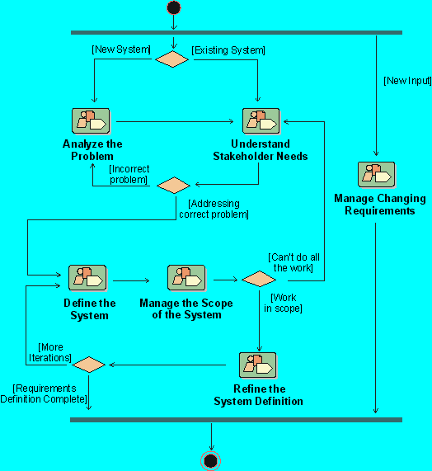
RUP Workflow Detail: Understanding Needs
Notes:
Where Does Understand Stakeholder Requests detail workflow fit in our development process? The Workflow Detail “Understanding Stakeholder Needs” in the Rational Unified Process represents activities that we undertake early in the requirements gathering process.
Where is this workflow detail done in your own software development process?
If presenting this course on-site at a company not using RUP, discuss the activities they use to accomplish this objective.

Slide 41
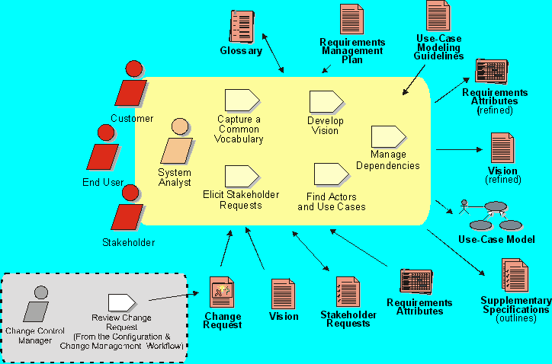
RUP Workflow Detail: Understanding Needs
Notes:
In RUP, the objective now is to collect and elicit information from stakeholders in the project. This information can be regarded as a "wish list" that will be used as primary input in defining use cases and supplementary requirements.
This workflow detail is performed mainly during iterations in the Inception and Elaboration phases. However, you should be aware of incoming stakeholder requests throughout the product lifecycle, to make sure you continue to address your stakeholders’ real needs.
The key activity is to elicit stakeholder requests and determine the requested features of the system. The primary outputs are collection(s) of prioritized Stakeholder Needs and Features, as well as the attributes which should be associated with them. These outputs will be recorded in the Vision document. Also, during this workflow, you may start discussing the system in terms of its use cases and actors.
Another important output is an updated Glossary of Terms to facilitate a common vocabulary among team members.
The key stakeholder needs will be documented in the Vision Document.

Slide 42
Review: Understanding Stakeholder Needs
1. What are some of the problems encountered in trying to understand user needs?
2. What is the basis of the “context-free” question?
  What are four categories of “context-free” questions?
  Give example questions in each category
3. What are some elicitation techniques you believe can be helpful in understanding your user’s needs?
  List some advantages and drawbacks of each
4. How are use cases helpful in eliciting user needs?
5. How would you plan a review of a customer-generated requirement spec?
Notes:
1.
2.
3.
4.
5.
Use these questions to monitor the students’ level of understanding and to help them review.
Tell them they can look back through the material to get the answers.
Give them time to answer Don’t be afraid to stand quietly while they look up the answer.
RECOMMENDED:
Finish, or almost finish, Module 4 by the end of Day 1.
If you get to the Requirements Review exercise at the end of Day 1, give them the exercise as homework. Then complete Module 4 at the beginning of Day 2.

